Slide 1




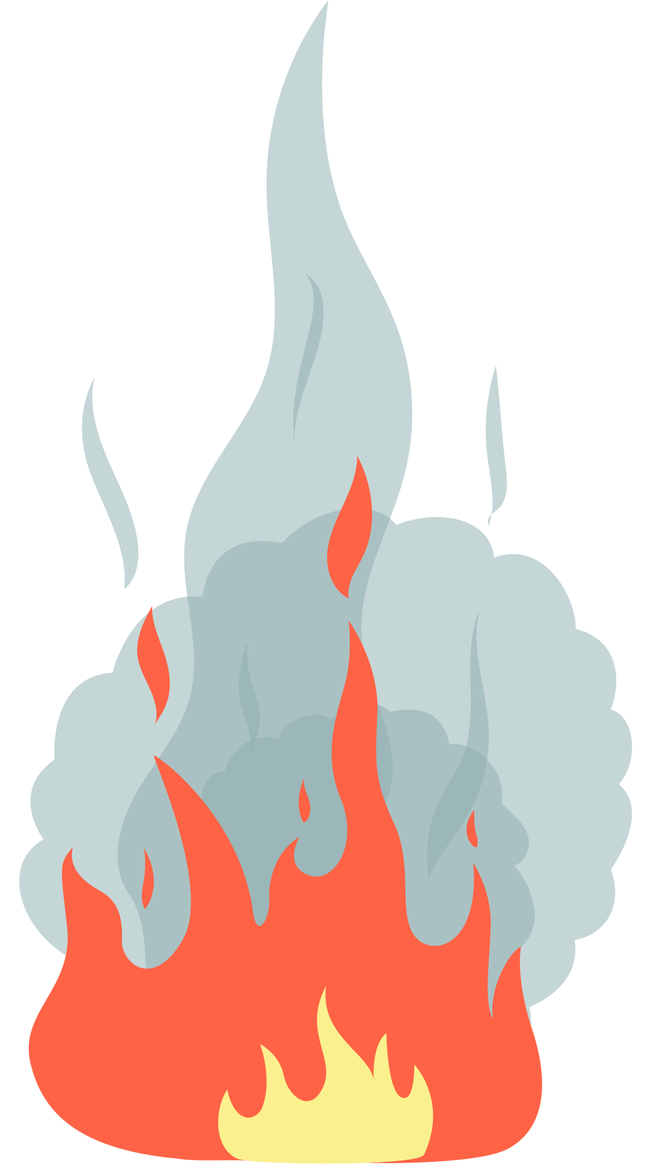
Thermo Dynamics

Slide 2
Zeroth Law of Thermodynamics
“When two objects are separately in thermodynamic equilibrium with a third object, they are in equilibrium with each other.”

Slide 3
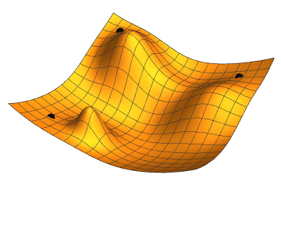
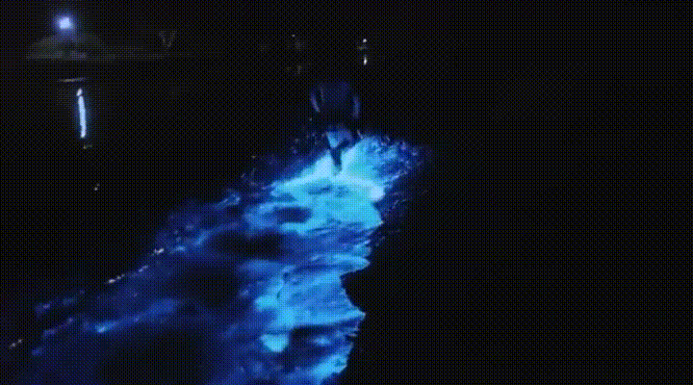
Energy
Objects that have “energy” are able to apply forces over a distance. This is called doing “work”.
There are many forms of energy such as gravitational potential energy, chemical energy, electrical energy, and kinetic energy.

Slide 4
Demo: Leyden Jar

Slide 5
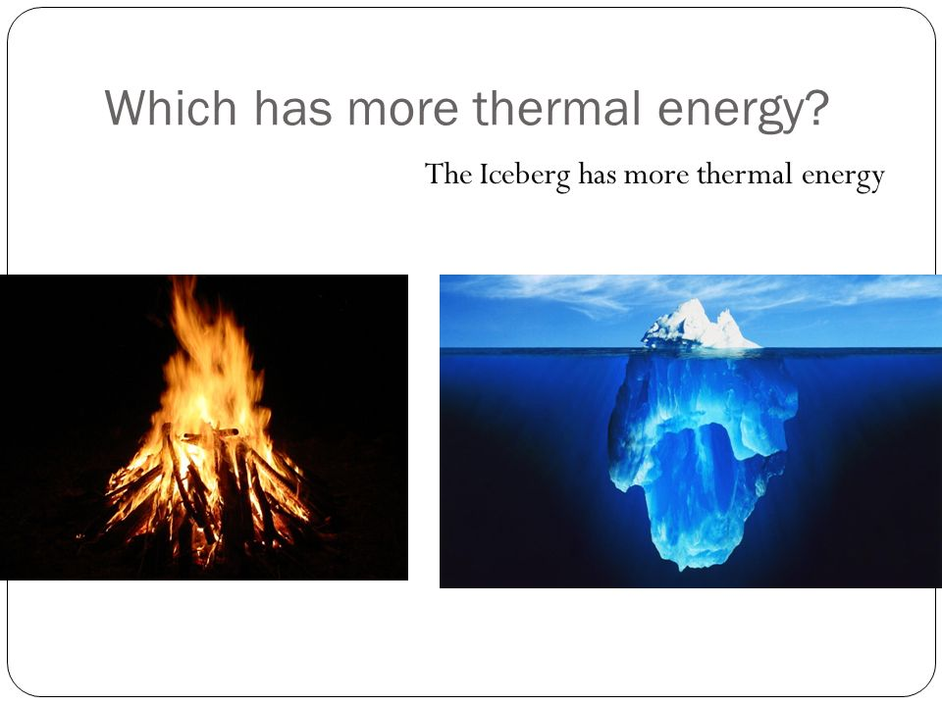
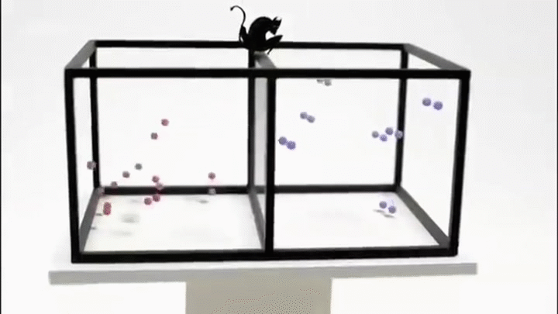
Temperature
Kinetic energy is energy from motion. The larger the velocity of an object, the larger the kinetic energy! In the context of thermodynamics, you may hear kinetic energy referred to as thermal energy.
Temperature is the average kinetic energy of an object.

Slide 6
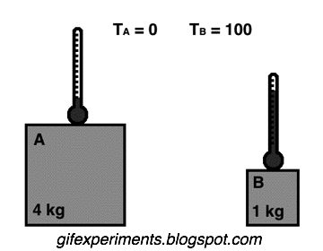
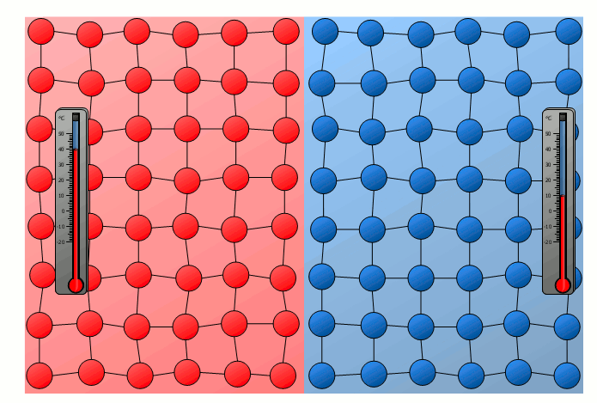
Equilibrium
When two objects touch, the object with a temperature will dissipate thermal energy to the lower temperature object.
When no more thermal energy is transferred, we say two objects are at thermal equilibrium.

Slide 7
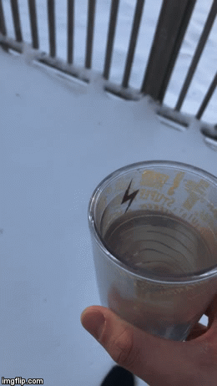
Thermal Expansion
Hotter things tend to expand. This is because the atoms within the object vibrate more, so they spread out.
Water is special! It actually expands when it cools below 4 degrees Celsius. Hot water and ice have similar volumes (sizes), so you can quickly freeze boiling water.

Slide 8
Demo: Rubber Band

Slide 9
First Law of Thermodynamics
“The internal energy (E) is equal to the difference of the heat transfer (Q) into a system and the work (W) done by the system.”

Slide 10
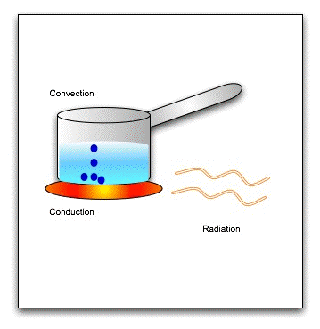
Heat
Thermal energy transferred between two bodies (of different temperatures) is called heat.

Slide 11
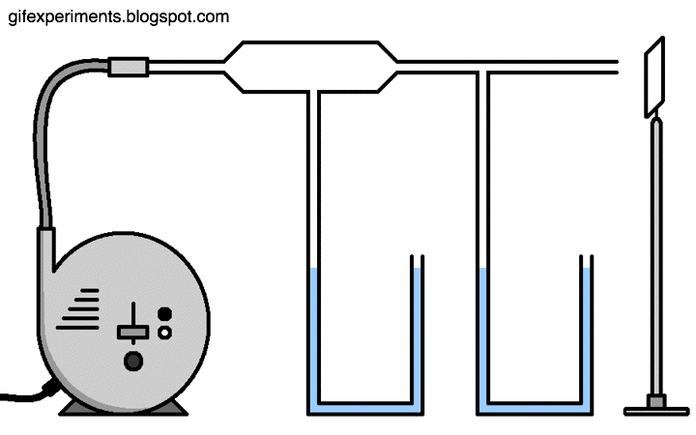
Pressure
Pressure is force distributed over a surface area.
The larger the surface area, the smaller the pressure.

Slide 12
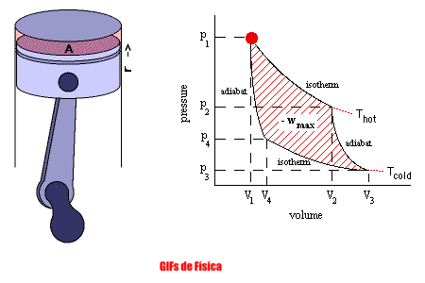
Work
Mechanical energy is referred to as work.
Mechanical energy is referred to as work. We generally see mechanical energy as changes in volume under a certain pressure.
Vibrations are also produced by mechanical energy. Sound is a form of mechanical energy!

Slide 13
Demo: Rubber Band

Slide 14
Demo: Mist Maker

Slide 15
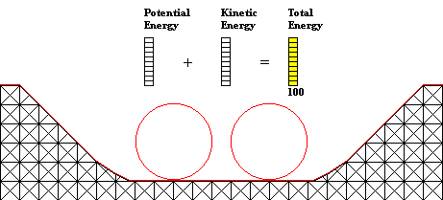
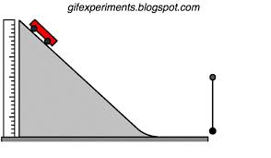
Conservation of Energy
The energy of the universe is constant.
Objects gain energy when they either gain heat energy or lose energy when they do work.

Slide 16
Demo: Soda Can

Slide 17
Demo: Candle

Slide 18
Second Law of Thermodynamics
“The total entropy of a system plus its environment can not decrease.”

Slide 19
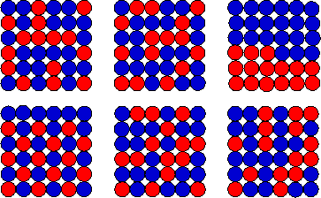
Microstates and Macrostates
Microstates are defined by how the individual atoms of a particular system are arranged.
Macrostates are a set of microstates with similar properties (temperature, volume, etc.)
For example, flipping 5 coins gives 32 microstates (there are 2 possibilities for each of the five coins), but only 6 macrostates (the number of heads ranges from 0-5).

Slide 20
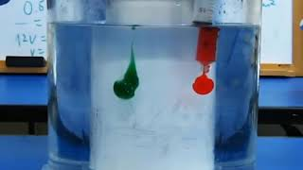
Entropy
A macrostates with many microstates has a higher probability (chance) of occurring than those with fewer microstates.
Entropy is related to the number of microstates. Thus, more probable macrostates have higher entropies.
Entropy always tends to increase in the long run, why?

Slide 21
Demo: Pennies

Slide 22
Questions?

